Slide 1
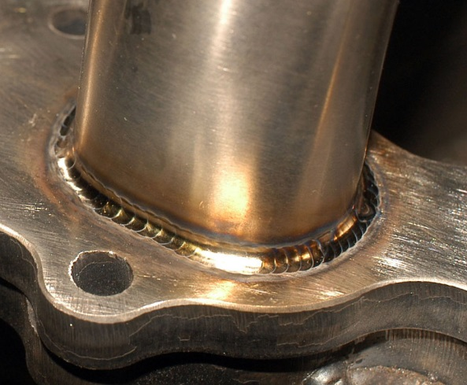
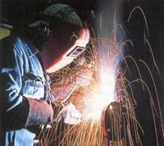

EDPT 601
Materials Manufacturing Technolgy
Lecture 10
Welding
Processes
Ref: Ch 37 DeGarmo
Ch 27 Kalpakjian
Prof. Nahed El Mahallawy,March 2020

Slide 2
Introduction to joining processes
JOINING can be done by:
Welding , brazing and soldering
Mechanical fastening using bolts, screws, rivets
Adhesive bonding for low temperature joining of composite materials
Shrink-fit, slots and tabs
Prof. Nahed El Mahallawy,March 2020

Slide 3
Introduction to welding processes
Welding and joining is necessary when large pieces with high degree of shape complexity or wide variation in required properties
Smaller pieces , easier to handle, simpler in shape, easier to manufacture, or segments of different materials can be joined
Without welding metal products would have been far more expensive and also drastically modified
Examples:
Steel structures, pipe lines,
ship hulls, tanks, containers,
electronic circuits etc..
Prof. Nahed El Mahallawy,March 2020

Slide 4
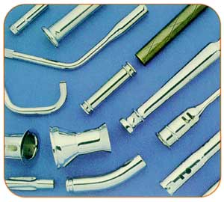
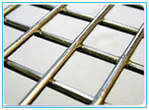
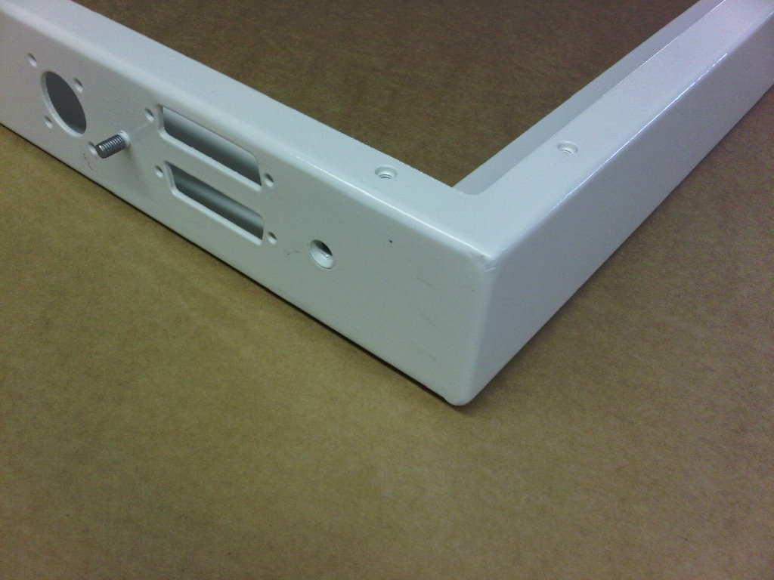
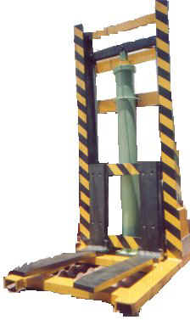
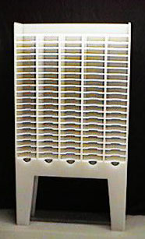
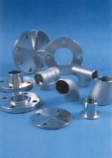
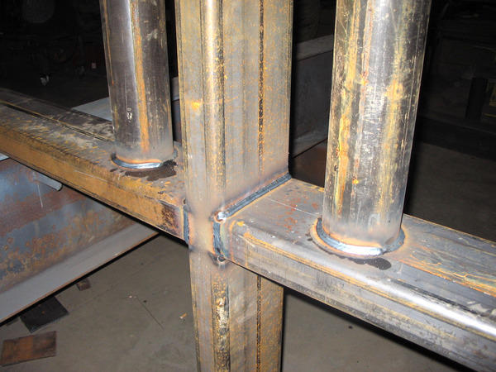
Examples of welded products
Welded wire mesh
Prof. Nahed El Mahallawy,March 2020
Stainless steel parts

Slide 5
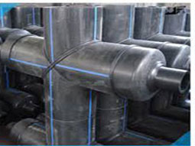
Prof. Nahed El Mahallawy,March 2020

Slide 6
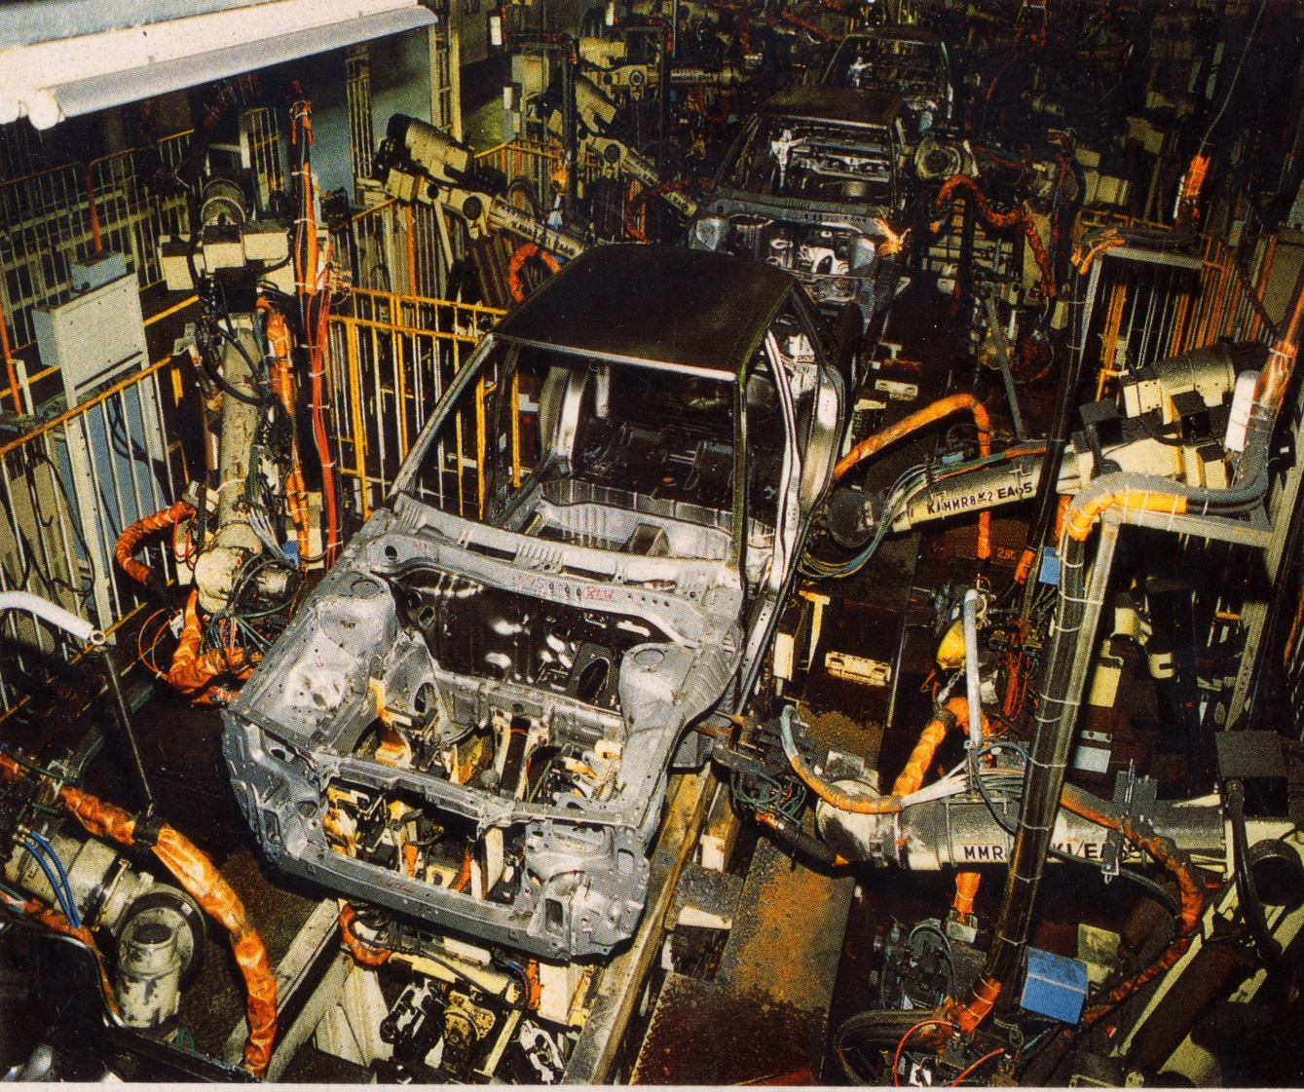
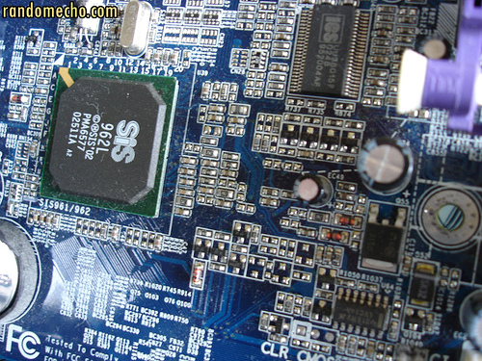
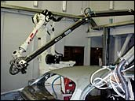
Welding in car body
Welding electrical
components
Prof. Nahed El Mahallawy,March 2020

Slide 7
What is welding? Welding is the permanent joining of two materials by coalescence
How to obtain this? For this a combination of temperature, pressure and metallurgical conditions are necessary
Which conditions are needed? Coalescence requires sufficient proximity and activity between the atoms of the pieces being joined to cause the formation of common crystals
For a high quality weld the following is required:
Source of heat and/or pressure
Means of protecting or cleaning metals to be joined
Caution to avoid or compensate for harmful metallurgical effects
Prof. Nahed El Mahallawy,March 2020

Slide 8
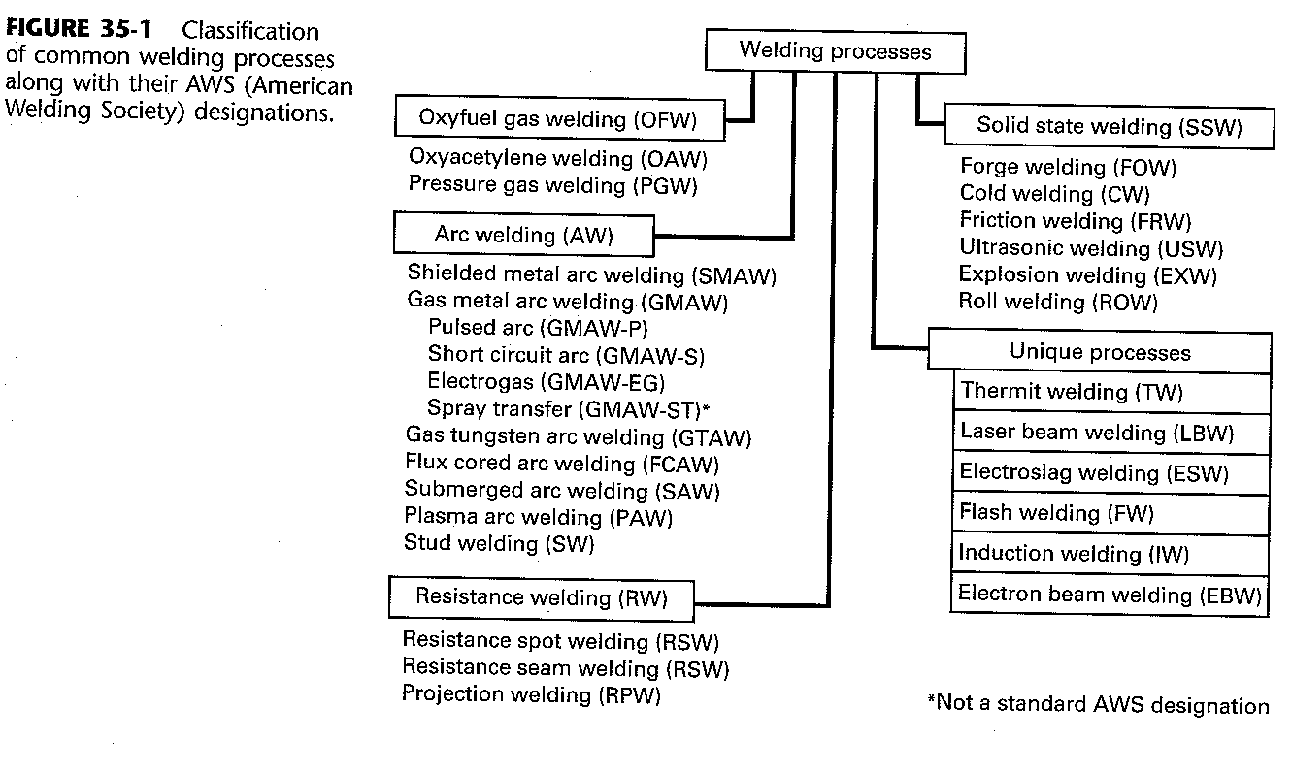
Classification of welding and thermal cutting processes
Prof. Nahed El Mahallawy,March 2020

Slide 9
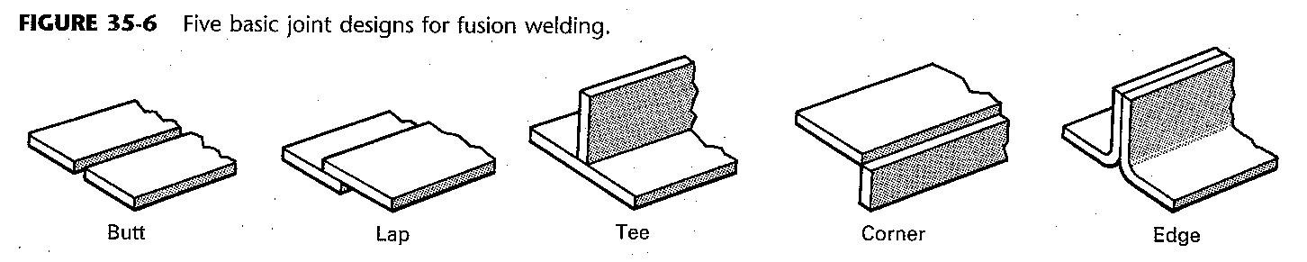
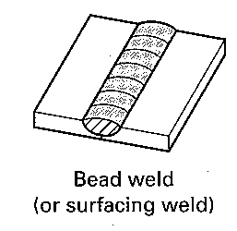
Basic joints design for fusion welding
Types of fusion welds and types of joints
Bead weld:
are made directly onto flat surface
Require no edge preparation
since penetration depth is limited, bead welds are used primarily for joining thin sheets, building up surfaces and depositing hard facing ( wear-resistant) materials
Prof. Nahed El Mahallawy,March 2020

Slide 10
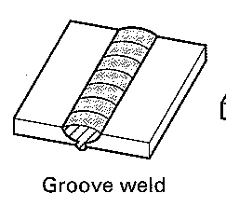
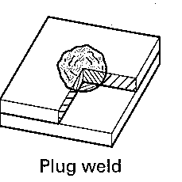
Groove welds
Are used when full-thickness strength is desired on thicker material
Edge preparation is required
Edges with V, double V, U and J ( one sided V) are often produced by oxyacetylene flame cutting
Type of groove depend on thickness of joint, welding process, and position of work
Objective is to obtain sound weld throughout the full thickness with minimum amount of additional weld metal
Single pass or multiple pass depending on thickness
Plug welds
Attach one part on top of the other
Used to replace rivets or bolts
A hole is made in top plate and welding is started at the bottom of this hole
Prof. Nahed El Mahallawy,March 2020

Slide 11
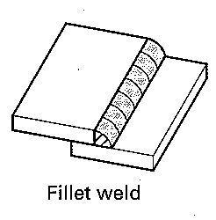
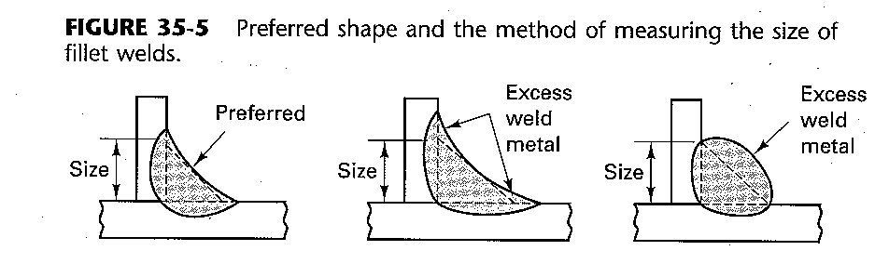
Fillet welds
Are used for tee, lap, corner joints
Require no edge preparation
A proper shape for fillet weld is needed to avoid excess metal deposition and reduce stress concentration
Prof. Nahed El Mahallawy,March 2020

Slide 12
Weld defects
Various types of weld defects can be produced such as:
Cracks various forms
Cavities , (both gas and shrinkage)
inclusions ( slag, flux and oxides)
Incomplete fusion between weld and base metal
Incomplete penetration (insufficient weld depth)
Unacceptable weld shape or contour
Arc strikes
Spatter
Undesirable metallurgical changes ( aging, grain growth or transformations)
Excessive distortions
Prof. Nahed El Mahallawy,March 2020

Slide 13
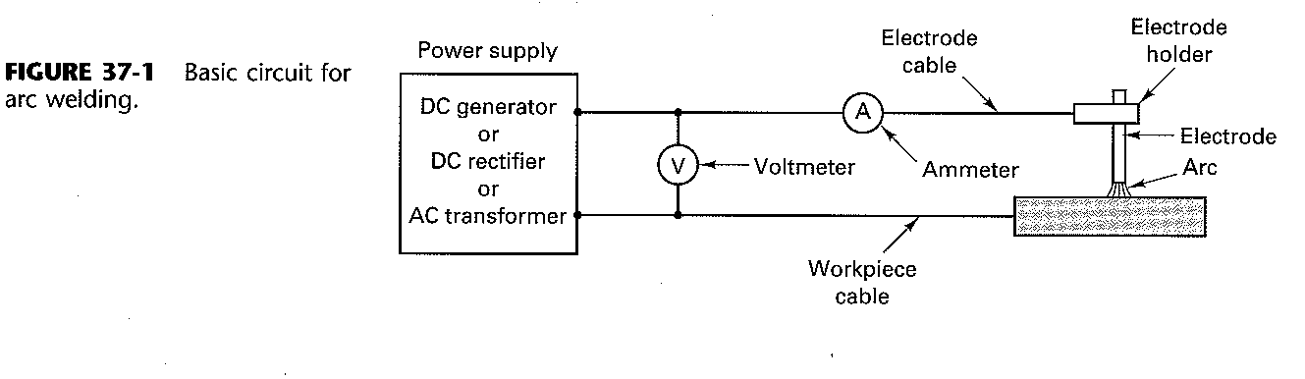

ARC WELDING:
Basic circuit
In arc welding, the heat required is obtained from electrical arc energy
Arc is produced between the tip of the electrode and the wp to be welded by the use of an arc of an AC or DC power supply
The arc produces a temp of about 4000°C
Prof. Nahed El Mahallawy,March 2020

Slide 14
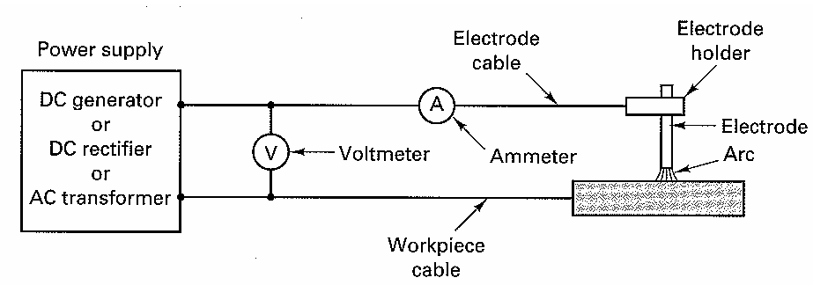
ARC WELDING PROCESS:
Welding currents vary from 1 to 4000 Amps with the range from 100 to 1000 being most typical
Voltages generally in the range from 20 to 50 volts
Straight polarity: DC with electrode is made negative. Electrons are attracted to the positive wp while ionized atoms in the arc column are accelerated toward the negative electrode
Since ions are more massive than electrons, heat of the arc is more concentrated at the electrode
Fast melting of the electrode
high deposition rate,
And a shallow molten
pool on the wp
( weld penetration)
is preferred for sheet metals
and for joints with very wide
gaps
electrode-ve
Sketch of the arc welding process
wp +ve
Prof. Nahed El Mahallawy,March 2020

Slide 15
Reverse polarity:
Work is made -ve and electrode is +ve
Positive ions impinge on wp breaking up any oxide film and giving deep penetration
Lower rate of metal deposition
AC current provides a 50-50
average of both types.
Arc pulsates rapidly- suitable for welding thick sections and for using large- diam. electrodes and maximum currents
Wp -ve
Prof. Nahed El Mahallawy,March 2020

Slide 16
Electrodes: consumable and non consumable
Consumable
non consumable
Tungsten electrode
A separate metal wire is required to supply the filler metal
Process parameters should be selected they include:
Welding volt and current
Arc polarity
Arc length
Welding speed
Arc atmosphere
Electrode or filler material and flux
Skilled labour is still needed but reduced in application of automation
Consumable type: supplies metal to the joint
Have a melting temperature below the arc temperature
Small droplets are melted from the end of electrode and pass to wp
Prof. Nahed El Mahallawy,March 2020

Slide 17
Consumable Electrode Arc Welding
There is a wide variety of arc processes which are widely used
The main processes are:
Shielded metal arc welding (SMAW)
Flux-cored arc welding (FCAW)
Gas metal arc welding ( GMAW)
Submerged arc welding (SAW)
Prof. Nahed El Mahallawy,March 2020

Slide 18
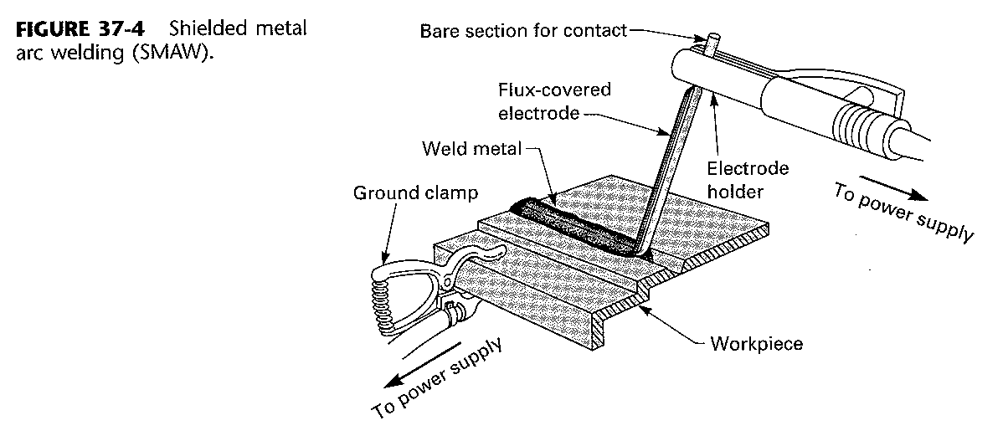
1. Shielded metal-arc welding
Is one of the oldest, simplest and most versatile joining process
It requires low cost equipment
About 50% of all industrial and maintenance welding is performed by this process
a finite – length electrode consists of a metal wire usually 1.5 to 6.5 mm diam. and 20 to 45 cm long
The process is also called stick welding
Prof. Nahed El Mahallawy,March 2020

Slide 19
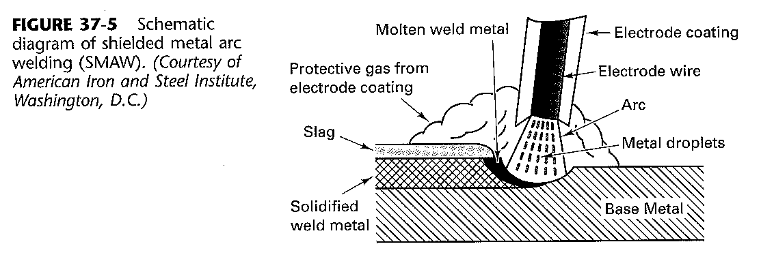
Other coating components surround the metal droplets with a layer of liquid flux and slag
Under decomposition the volatile matter may release hydrogen which can dissolve in weld metal and cause embrittlement or cracking in the joint
Low hydrogen electrodes are available which provide shielding without hydrogen emission
Since many electrode coatings may absorb hydrogen, coated electrodes are baked just before use
Current is generally 40Amp per millimeter of electrode diam.
Upon heating , part of the electrode coating melts and vaporizes forming a protective atmosphere of CO,CO2 and other gases that stabilize the arc and protects the molten and hot metal from contamination
Prof. Nahed El Mahallawy,March 2020
Notes:
Electric arc is generated by touching the tip of the electrode against the wp then withdrawing it quickly to a distance sufficient to maintain the arc
Current range: 50 A and 300A – power required less than 10 kW – AC or DC- for sheet metal welding DC is preferred due to arc stability and shallow penetration

Slide 20
Functions of the wire electrode coating
The wire is surrounded by a coating containing chemical components to:
Vaporize to provide a protective atmosphere ( shield around the arc and molten pool)
Provide ionizing elements to help stabilizing the arc, reduce weld metal spatter and increase efficiency of deposition
Act as a flux to deoxidize and remove impurities from molten metal
Provide protective slag coating to accumulate impurities, prevent oxidation and slow down the cooling of the weld metal
Add alloying elements
Add additional filler metal
Affect arc penetration ( depth of melting in wp)
Influence the shape of weld bead
Prof. Nahed El Mahallawy,March 2020

Slide 21
The fluxing constituents unite with any impurities in the molten metal and float them to the surface where they are entrapped in the slag coating that forms over the weld
This slag coating protects the cooling ,metal from oxidation and slow down the cooling rate to prevent formation of hard brittle structures
This slag is glassy and is easily removed after cooling
Iron powder and alloying elements can be incorporated to the coat to adjust the chemistry of the weld
Prof. Nahed El Mahallawy,March 2020

Slide 22
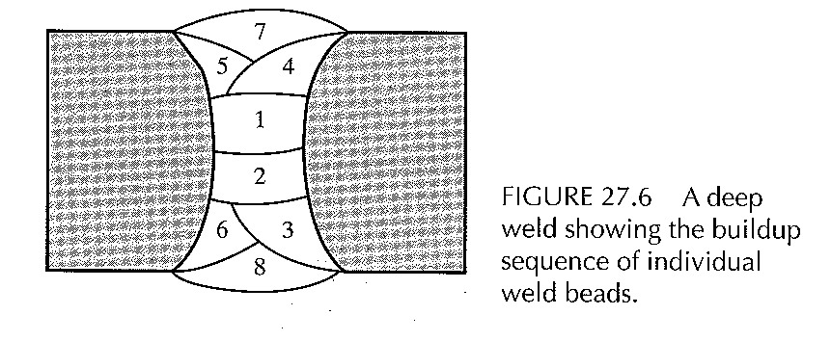
Process capabilities
SMAW has the advantages of being relatively simple and versatile and requiring a smaller variety of electrodes
Is used in general construction, ship building, on pipe lines, and maintenance work
Is useful for work in remote areas where portable fuel – powered generator can be used for power supply
Is suitable for wp thicknesses of 3 to 19mm and more using multiple-pass
Prof. Nahed El Mahallawy,March 2020

Slide 23
2. Fluxed-cored arc welding (FCAW)
Is similar to SMAW except that the electrode is tubular and the powdered flux is inside (cored)
Higher weld deposition rate compared to GMAW has led to its use in welding sections of all thicknesses
Can be made continuous and less bulky as no binders are required to hold the flux in place- more flexible- fed automatically through a welding gun- can be provided in long coiled lengths
Easily automated
Cored electrodes produce more stable arc, improve weld contour, and produce better mechanical properties of weld
Electrodes are usually 0.5mm to 4mm . Smaller diam electrodes allow welding of thinner materials and to weld parts in different positions
When the arc is established , the vaporizing flux again produces a protective atmosphere and also forms a slag over the weld pool
flux with almost a wide variety of weld chemistry can be achieved therefore allowing welding of many metals
By adding alloying elements to the flux core, virtually any alloy composition can be developed
Used mainly on steels, stainless steels and nickel alloys
Prof. Nahed El Mahallawy,March 2020

Slide 24
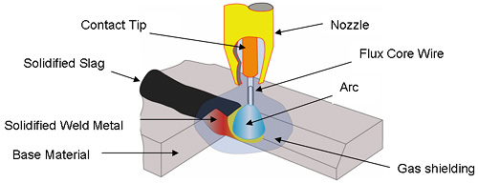
Prof. Nahed El Mahallawy,March 2020

Slide 25
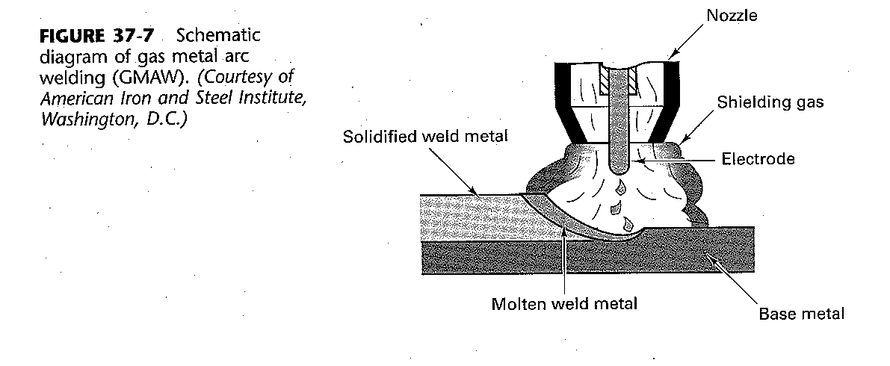
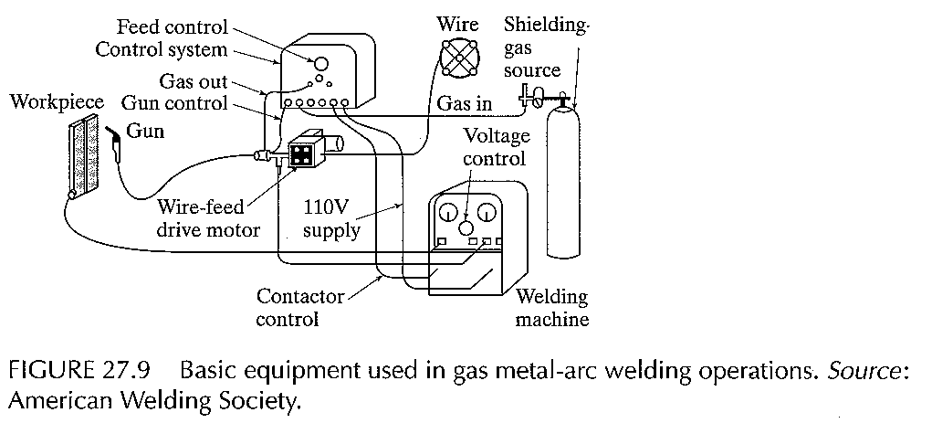
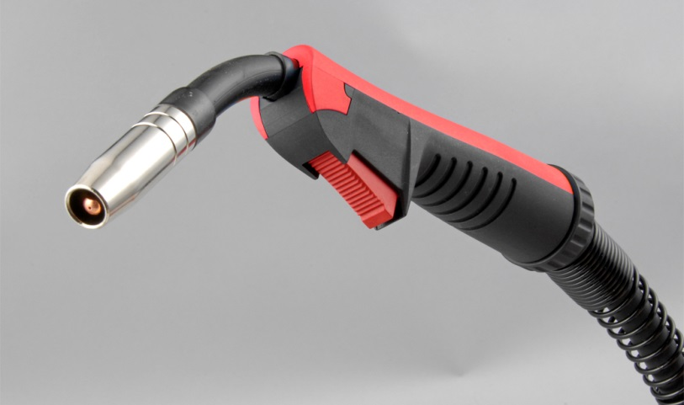
3. Gas Metal Arc Welding (GMAW) previously called (MIG)
In this process the weld area is shielded by argon atmosphere , helium, carbon dioxide or other gas mixtures
The consumable wire is bare and fed through a nozzle into the weld arc
Prof. Nahed El Mahallawy,March 2020

Slide 26
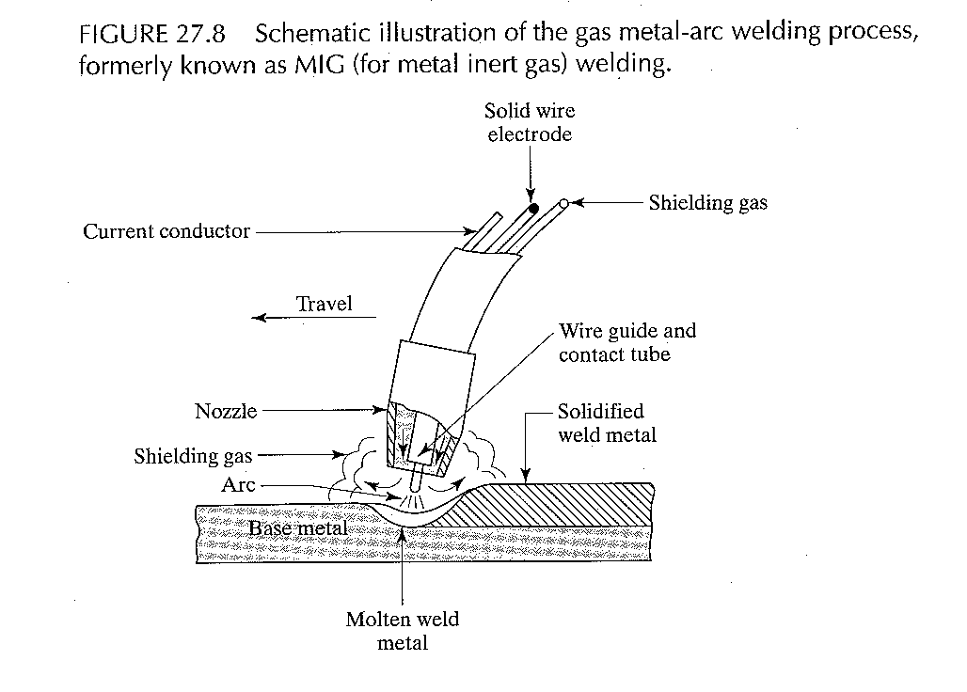
Deoxidizers are usually present in the electrode metal itself in order to prevent oxidation of molten pool
Multiple layers can be deposited at the joint without cleaning after each pass
No flux
Prof. Nahed El Mahallawy,March 2020

Slide 27
Process capabilities
GMAW is suitable for welding a variety of ferrous and non-ferrous metals
Is used extensively in metal-fabrication industry
Process is simple - easy training of operator
Process is versatile, rapid, economical, welding productivity double that of SMAW
Can be easily automated
A direct current electrode positive (DCEP) arc is generally used because of its deep penetration, spray transfer and ability to produce smooth welds with good profile
Prof. Nahed El Mahallawy,March 2020

Slide 28
4. Submerged Arc Welding
Weld arc is shielded by a granular flux consisting of lime, silica, manganese oxide, calcium fluoride and other components
Flux covers molten metal: preventing spatter and sparks and suppresses the intense ultraviolet radiation and fumes
Flux acts also as thermal insulator, promoting deep penetration of heat into wp
Consumable electrode is a coil of bare wire 1.5 mm to 10 mm diam. - Is fed automatically
Typical electric currents range between 300 A and 2000 A
Prof. Nahed El Mahallawy,March 2020

Slide 29
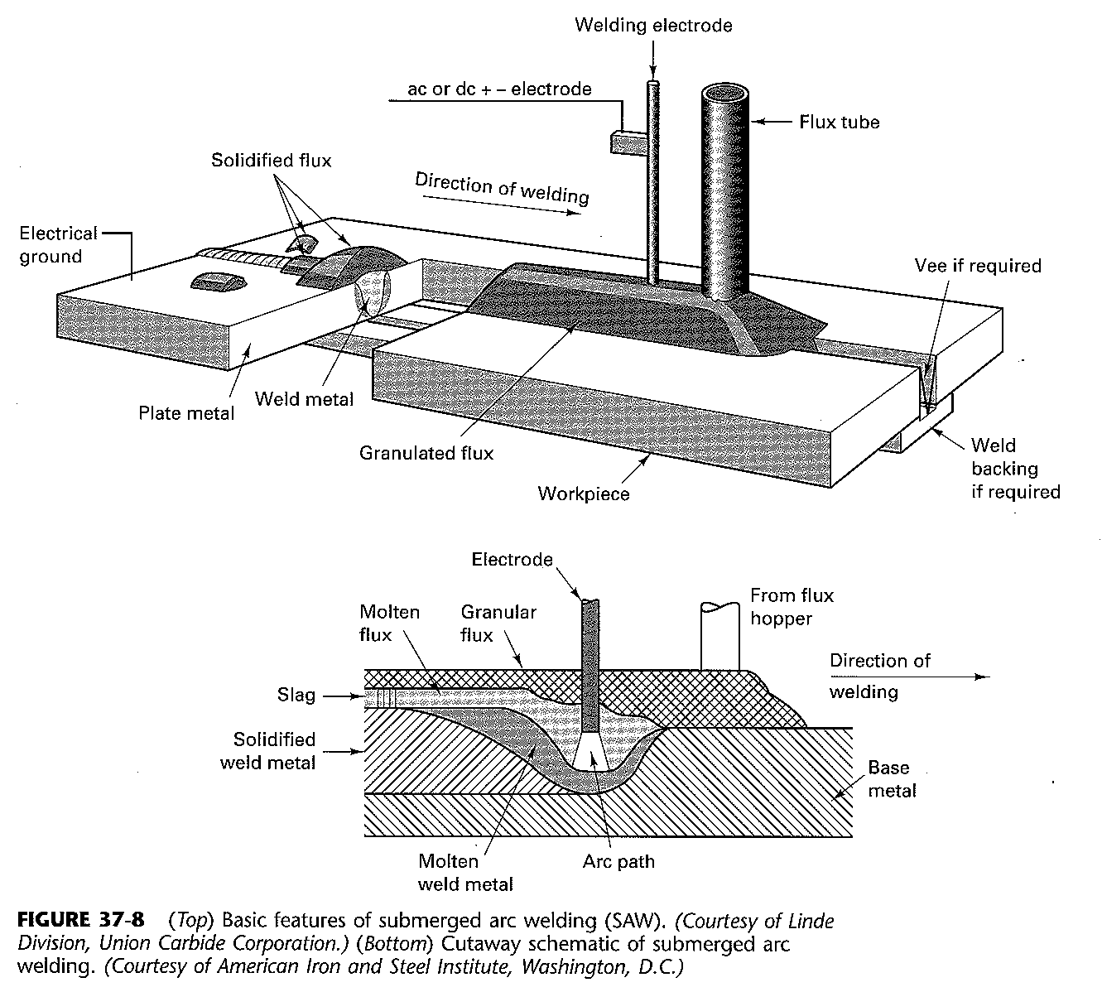
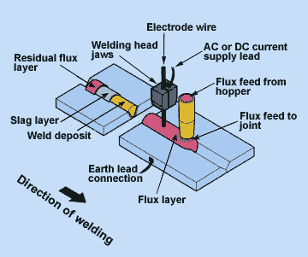
Prof. Nahed El Mahallawy,March 2020

Slide 30
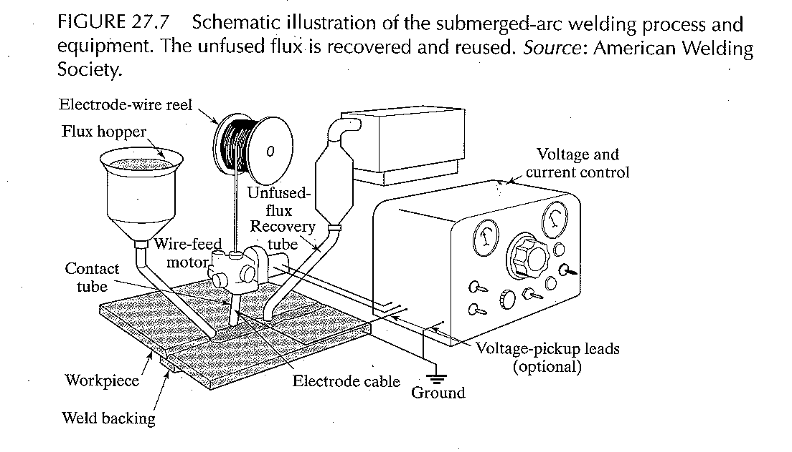
Prof. Nahed El Mahallawy,March 2020

Slide 31
Process capabilities
Because flux is fed by gravity, the process is limited to welds in flat or horizontal positions and having a back-up piece
Circular welds can be made on pipes if rotated during welding
Is used carbon and alloy steels, stainless steel
Very high quality of weld, with good toughness, ductility and uniformity in properties
Very high welding productivity , depositing 4 to 10 times the amount of SMAW
Typical applications: thick plates welding for shipbuilding and for pressure vessels
Prof. Nahed El Mahallawy,March 2020

Slide 32
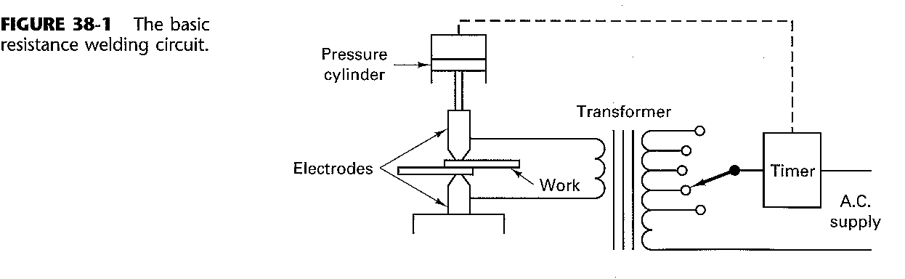
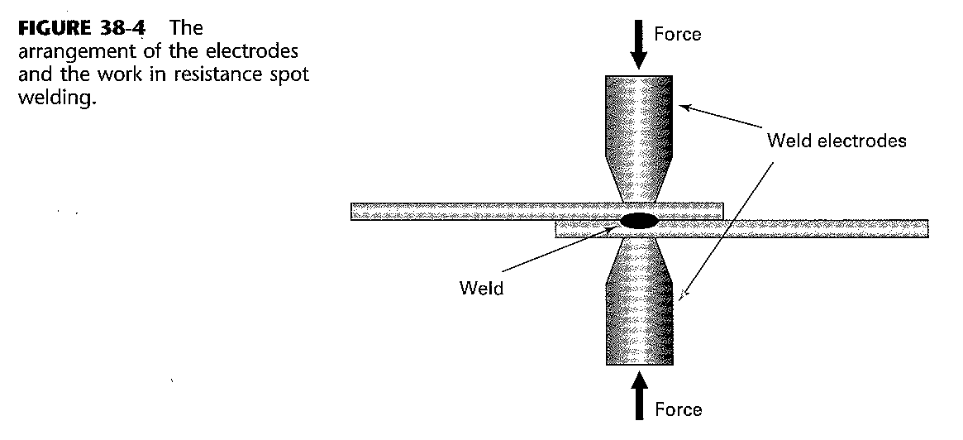
Resistance Welding
Theory of resistance welding
Both heat and pressure are used to induce coalescence
Electrodes are placed in contact with the material and electrical resistance heating is used to raise the temp of the wp and the interface between them
Prof. Nahed El Mahallawy,March 2020
Notes:
Resistance welding is a type of solid state welding.
Electrodes supply current and pressure

Slide 33
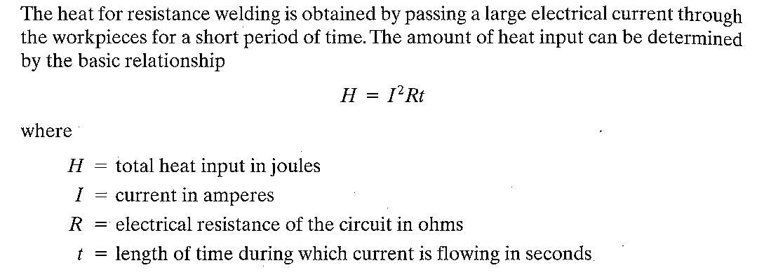
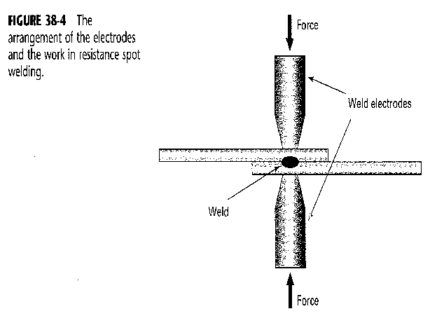
Principles
Melting of the base metal usually does not occur
It is a form of solid-state welding
Coalescence is achieved in a few seconds- very rapid- economical
Can be automated
No filler
No flux or shielding gases
Electrodes supply the current and pressure
Prof. Nahed El Mahallawy,March 2020

Slide 34
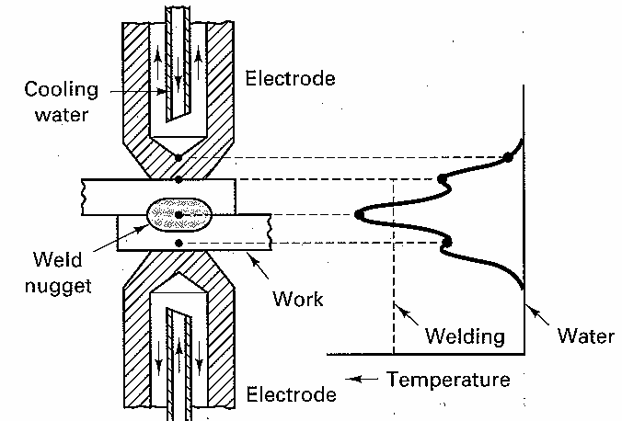
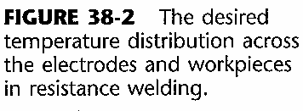
Temperature distribution
Note:
the electrode is water cooled
the position of max temperature
Sources of electrical resistances are :
1. Work piece ( wp) ,
2. contact resistance between electrodes and wp,
3. resistance between surfaces to be joined, faying surfaces
4. Resistance of electrodes
The maximum amount of heat should be generated at the point of max resistance
where the weld is to be made
Prof. Nahed El Mahallawy,March 2020

Slide 35
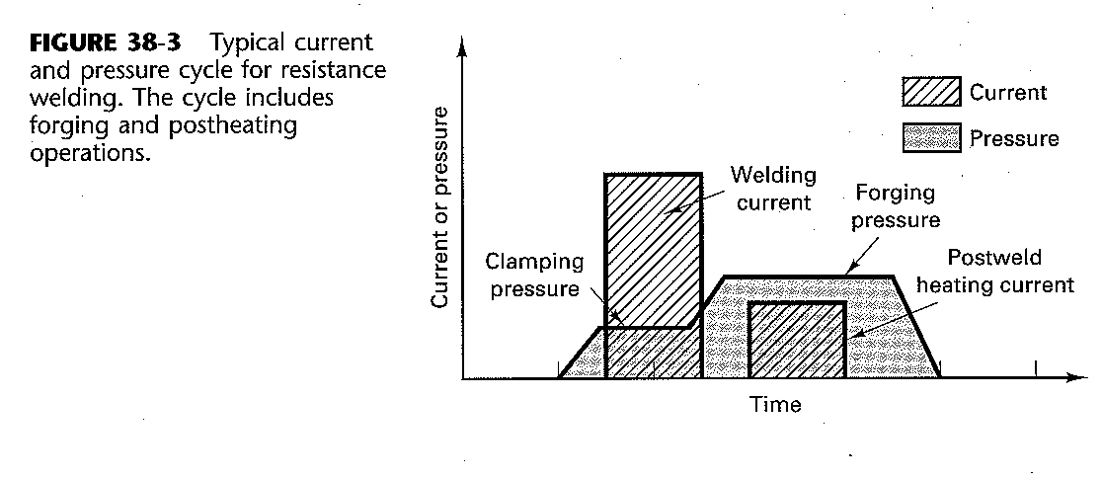
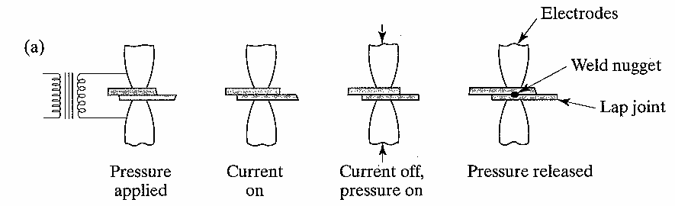
Sequence of resistance spot welding:
Pressure is increased as the proper welding temp is attained
- temp. lower than other welding techniques -- forge welding- fine grained structure
Prof. Nahed El Mahallawy,March 2020
Notes:
Note :
The welding cycle must be programmed first then applied automatically upon start of the process
Note the changes of pressure and current applied during the welding cycle
High currents and short time intervals enable the weld location to attain the desired temp. with minimum heat dissipated to adjacent material
Moderate pressure should be applied to hold the wp together and establish proper resistance at the interface prior and during passage of current. Pressure is then increased to the forging pressure as the welding temp. is attained

Slide 36
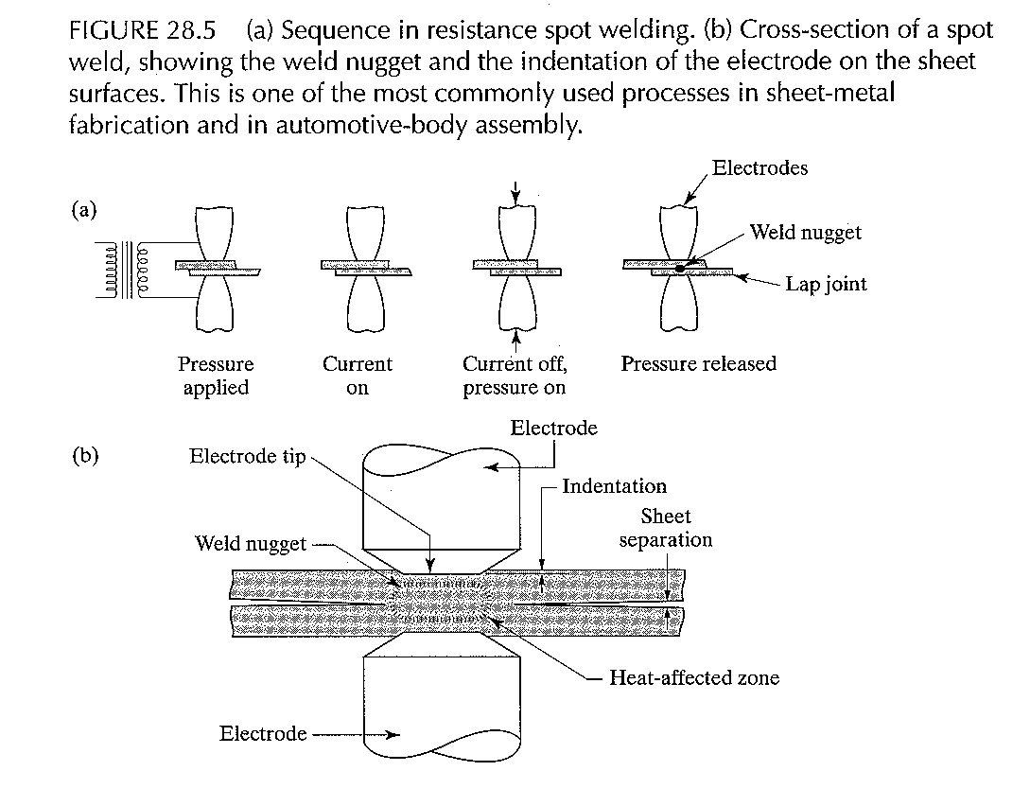
Prof. Nahed El Mahallawy,March 2020

Slide 37
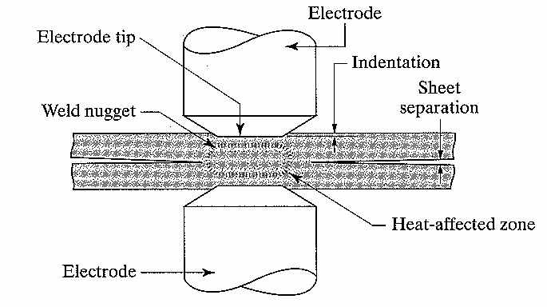
Effect of Pressure:
Too little pressure, contact resistance too high and surface burning or pitting of electrodes may result
If excessive pressure , molten or soft metal may be expelled from between faying surfaces or softened wp may be indented by electrodes
Moderate pressure should be applied to hold the wp together and establish proper resistance at the interface prior and during passage of current. Pressure is then increased to the forging pressure as the welding temp. is attained
Prof. Nahed El Mahallawy,March 2020

Slide 38
Current:
Is determined by magnitude and duration
High currents and short time intervals gives desired temp. with min. amount of heat dissipated to adjacent material
Magnitude, duration and timing of both current and pressure are programmed to follow specified cycles
Power supply
Since overall resistance is quite low, high currents are generally required to produce the weld
Power transformers converts high-voltage low-current power to high-current (up to 100000A) low voltage (0.5 to 10V) power
Many welding machines use DC current- gives reduced current demand per phase and produce excellent welds
Prof. Nahed El Mahallawy,March 2020

Slide 39
Spot weldable metals
Sheets to sheets of similar or dissimilar thickness usually min. 3mm
Rolled steel to cast steel or some types of non ferrous castings
Most metals require no special surface preparation except heavy corrosion or pitting
Aluminum and magnesium should be cleaned directly before welding
Metals with high thermal conductivity are difficult to weld- require higher current
In case of sheets of different thicknesses: larger electrodes are used to bring both wp to desired temp simultaneously
Prof. Nahed El Mahallawy,March 2020

Slide 40
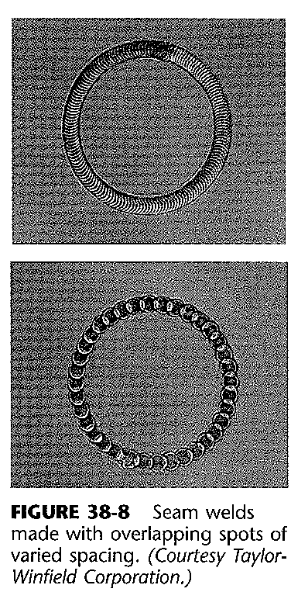
Seam Welding
There are two methods:
Overlapping spot welds- for sheet to produce gas or liquid-tight vessels e.g. gas tanks, mufflers, simple heat exchangers metal
Prof. Nahed El Mahallawy,March 2020

Slide 41
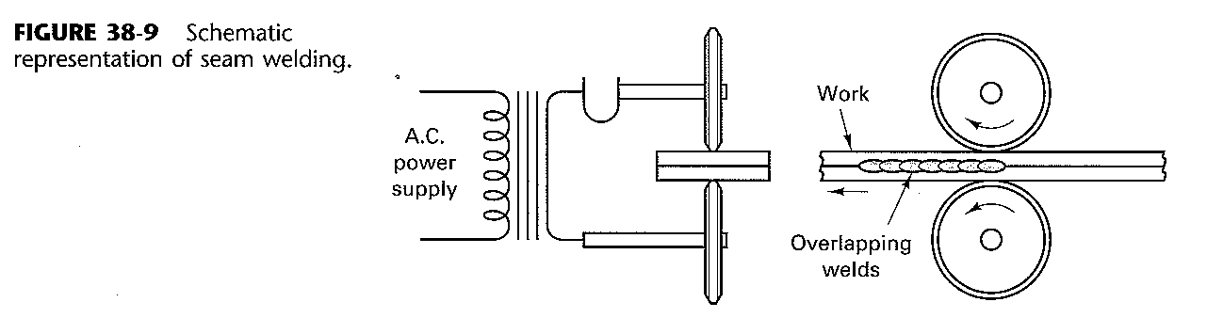
Basic equipments is similar to spot welding except that electrodes are in form of rotating disks
Timing of operation is adjusted with sheet movement
Prof. Nahed El Mahallawy,March 2020

Slide 42
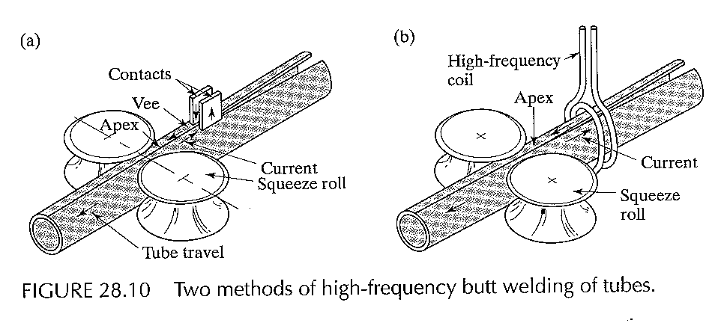
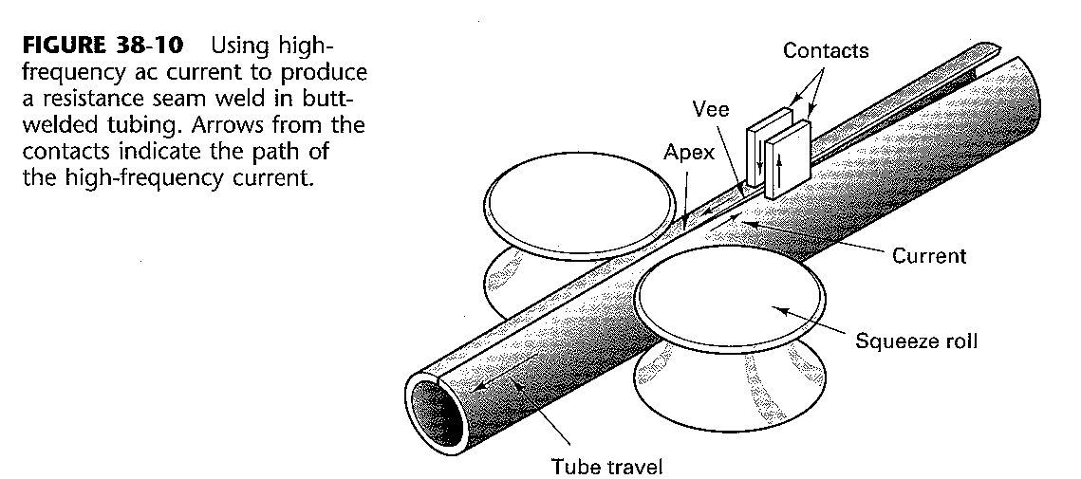
2. Resistance butt welding of tubes:
- is applied largely for pipes and tubes, and thick plates
- Material from 0.1mm to more than 20mm thick can be welded
Prof. Nahed El Mahallawy,March 2020
Notes:
Butt welds between thicker metal plates- high frequency current are used to generate heat then plates are pressed against each other

Slide 43
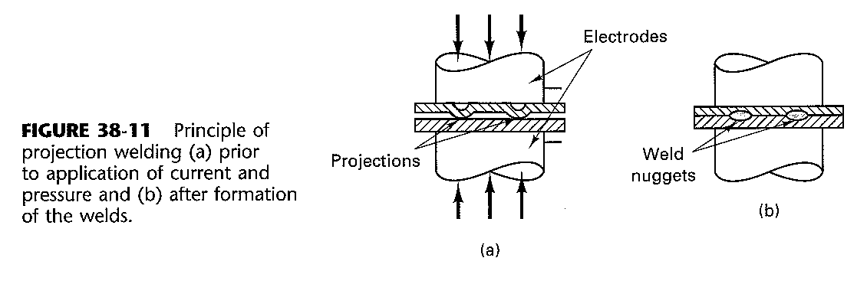
Projection welding
Provides longer electrode life ( larger area and less current density) and produces several welds at a time
Dimples are first embossed – current flows in points of contact- then as the metal heats and becomes plastic, pressure causes dimples to flatten and form the weld
Prof. Nahed El Mahallawy,March 2020

Slide 44
Projection welding is attractive as:
Dimple ( any shape) is embossed into the wp at the location where weld is desired
Large electrodes are used while heat is concentrated in small areas-hence, longer electrode life
Multiple welds can be produced at one time- limited by current and pressure
No indentation or marks on exterior surface- good appearance
Conventional spot welding m/c can be converted into projection welding by changing the electrode size and shape
Prof. Nahed El Mahallawy,March 2020

Slide 45
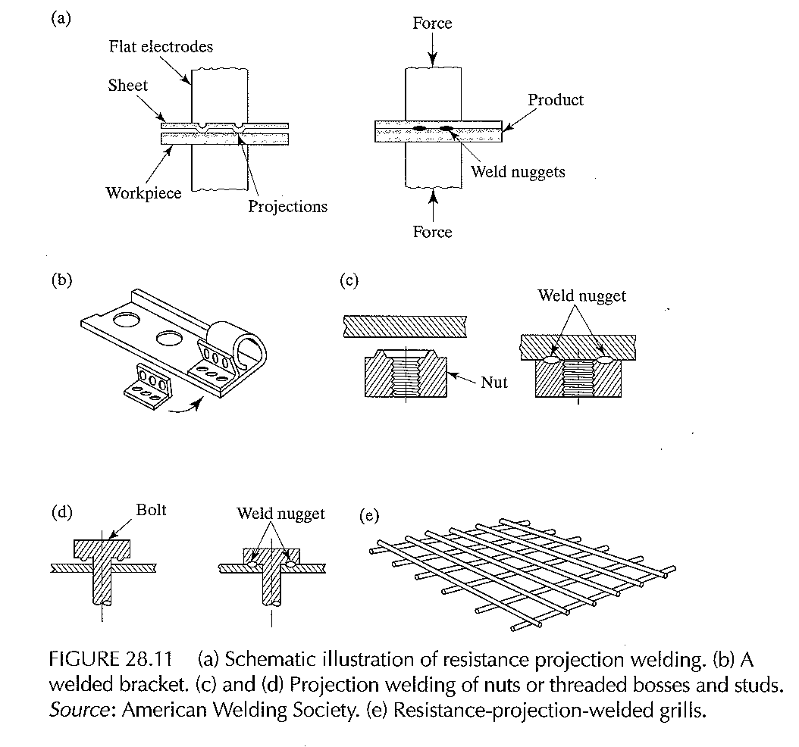
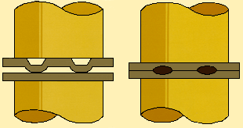

Prof. Nahed El Mahallawy,March 2020
Notes:
Some applications of projection welding

Slide 46


Advantages and limitations of resistance welding
Prof. Nahed El Mahallawy,March 2020

Slide 47
Review questions
What are the basic 3 types of current and polarity that are used in arc welding? What are the applications of each type?
What is the difference between consumable and non consumable electrode? For which process must a filler metal be added by a separate mechanism?
What are the 3 types of metal transfer in arc welding? Mention some typical features and applications
What are the 4 primary consumable arc welding processes? Mention the main features of each one.
What are the functions of electrode coating used in shielded metal arc welding?
Why are electrodes often backed just prior to welding?
What are the functions of the slag coating formed on the weld metal?
What is the advantage of placing the flux in the center of the electrode? What is the name of the process?
What are some advantages of gas metal arc welding compared to the shielded metal arc process?
What are the functions of the flux in submerged arc welding and what are the main advantages and applications? Minor limitations?
What are some of the attractive features of gas tungsten arc welding?
How are electrodes for arc welding designated?
What is the principle of resistance welding ?
Draw the temperature distribution across the weld and the pressure-time and the temperature-time curves in a welding cycle
What is the difference between spot and seam welding? Give examples of products
How can resistance welding be used in tube manufacturing
What is projection welding and its advantages and limitations Give some applications
Prof. Nahed El Mahallawy,March 2020

